Slide 1

Hardware Simulator Tutorial
This program is part of the software suite
that accompanies the book
The Elements of Computing Systems
by Noam Nisan and Shimon Schocken
MIT Press
www.nand2tetris.org
Developed by students at the
Efi Arazi School of Computer Science Reichman University
Chief Software Architect: Yaron Ukrainitz

Slide 2
Background
The Elements of Computing Systems evolves around the construction of a complete computer system, done in the framework of a 1- or 2-semester course.
In the first part of the book/course, we build the hardware platform of a simple yet powerful computer, called Hack. In the second part, we build the computer’s software hierarchy, consisting of an assembler, a virtual machine, a simple Java-like language called Jack, a compiler for it, and a mini operating system, written in Jack.
The book/course is completely self-contained, requiring only programming as a pre-requisite.
The book’s web site includes some 200 test programs, test scripts, and all the software
tools necessary for doing all the projects.

Slide 3
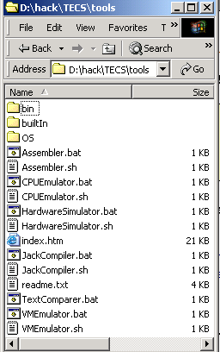
The book’s software suite
(All the supplied tools are dual-platform: Xxx.bat starts
Xxx in Windows, and Xxx.sh starts it in Unix)
Simulators
(HardwareSimulator, CPUEmulator, VMEmulator):
Used to build hardware platforms and
execute programs;
Supplied by us.
This tutorial is about the hardware simulator.
Translators (Assembler, JackCompiler):
Used to translate from high-level to low-level;
Developed by the students, using the book’s specs; Executable solutions supplied by us.
Other
Bin: simulators and translators software;
builtIn: executable versions of all the logic gates and chips mentioned in the book;
OS: executable version of the Jack OS;
TextComparer: a text comparison utility.

Slide 4


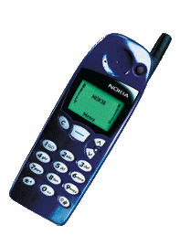
The Hack computer
The hardware simulator described in this tutorial can be used to build and test many different hardware platforms. In this book, we focus on one particular computer, called Hack.
Hack -- a 16-bit computer equipped with a screen and a keyboard -- resembles hand-held computers like game machines, PDA’s, and cellular telephones.
The first 5 chapters of the book specify the elementary gates, combinational chips, sequential chips, and hardware architecture of the Hack computer.
All these modules can be built and tested using the hardware simulator described in this tutorial.
That is how hardware engineers build chips
for real: first, the hardware is designed,
tested, and optimized on a software
simulator. Only then, the resulting
gate logic is committed to silicon.

Slide 5
Hardware Simulation Tutorial
I. Getting started
II. Test scripts
III. Built-in chips
IV. Clocked chips
V. GUI-empowered chips
VI. Debugging tools
VII. The Hack Platform
Relevant reading (from “The Elements of Computing Systems”):
Chapter 1: Boolean Logic
Appendix A: Hardware Description Language
Appendix B: Test Scripting Language

Slide 6

Hardware Simulation Tutorial
Part I:
Getting Started

Slide 7
Chip Definition (.hdl file)
/** Exclusive-or gate. out = a xor b */
CHIP Xor {
IN a, b;
OUT out;
// Implementation missing.
}
chip
interface
Chip interface:
  Name of the chip
  Names of its input and output pins
  Documentation of the intended chip operation
Typically supplied by the chip architect; similar to an API, or a contract.

Slide 8
Chip Definition (.hdl file)
/** Exclusive-or gate. out = a xor b */
CHIP Xor {
IN a, b;
OUT out;
PARTS:
Not(in=a, out=nota);
Not(in=b, out=notb);
And(a=a, b=notb, out=w1);
And(a=nota, b=b, out=w2);
Or(a=w1, b=w2, out=out);
}
chip
interface
chip implementation
Any given chip can be implemented in several different ways. This particular implementation is based on: Xor(a,b) = Or(And(a,Not(b)), And(b,Not(a)))
Not, And, Or: Internal parts (previously built chips), invoked by the HDL programmer
nota, notb, w1, w2: internal pins, created and named by the HDL programmer; used to connect internal parts.

Slide 9
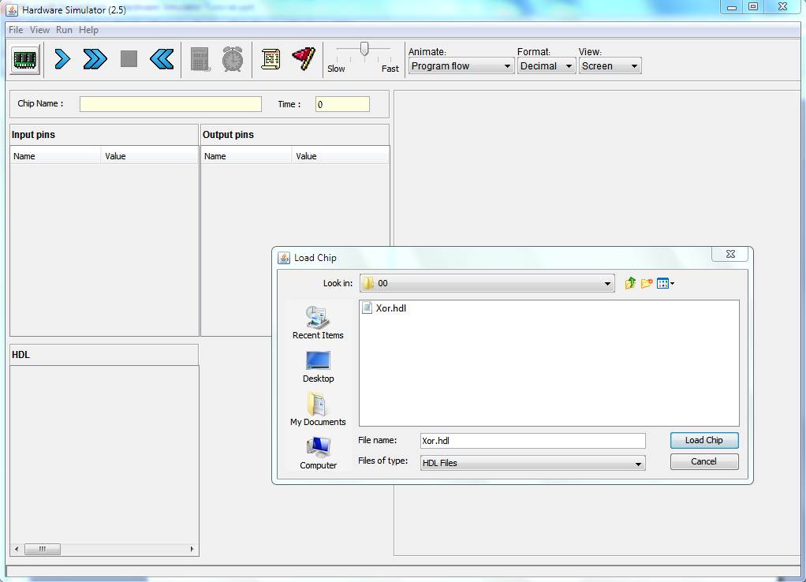
Loading a Chip
Navigate to a directory and select an .hdl file.

Slide 10
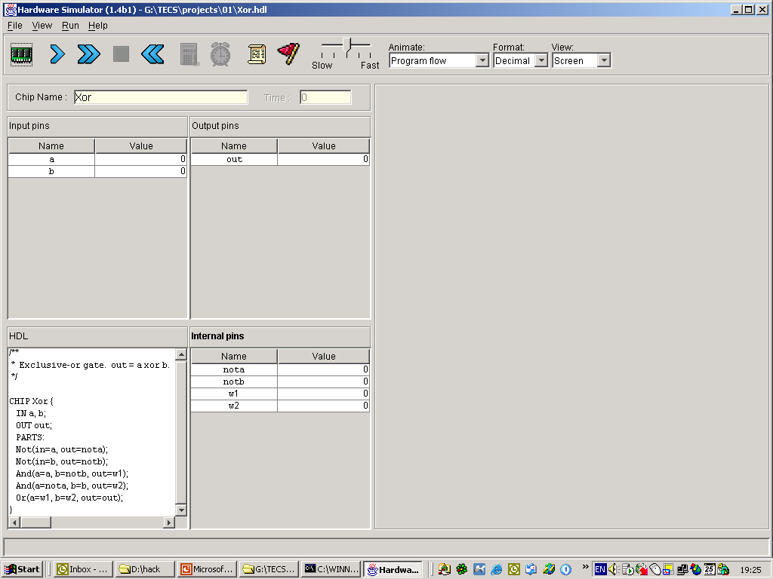
Loading a Chip
Names and current values of the chip’s output pins;
Calculated by the simulator; read-only.
Names and current values of the chip’s input pins;
To change their values, enter the new values here.
Names and current values of the chip’s internal pins
(used to connect the chip’s parts, forming the chip’s logic);
Calculated by the simulator; read-only.
Read-only view of the loaded .hdl file;
Defines the chip logic;
To edit it, use an external text editor.

Slide 11
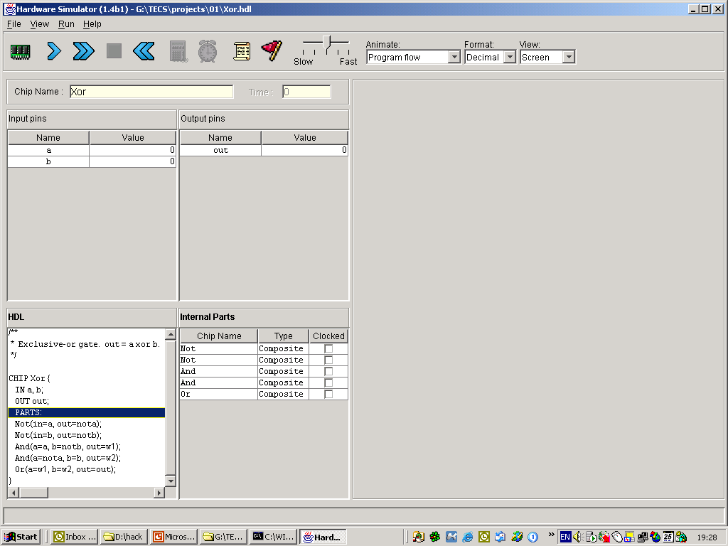
Exploring the Chip Logic
2. A table pops up, showing the chip’s internal parts (lower-level chips) and whether they are:
Primitive (“given”) or composite (user-defined)
Clocked (sequential) or unclocked (combinational)
1. Click the PARTS keyword

Slide 12
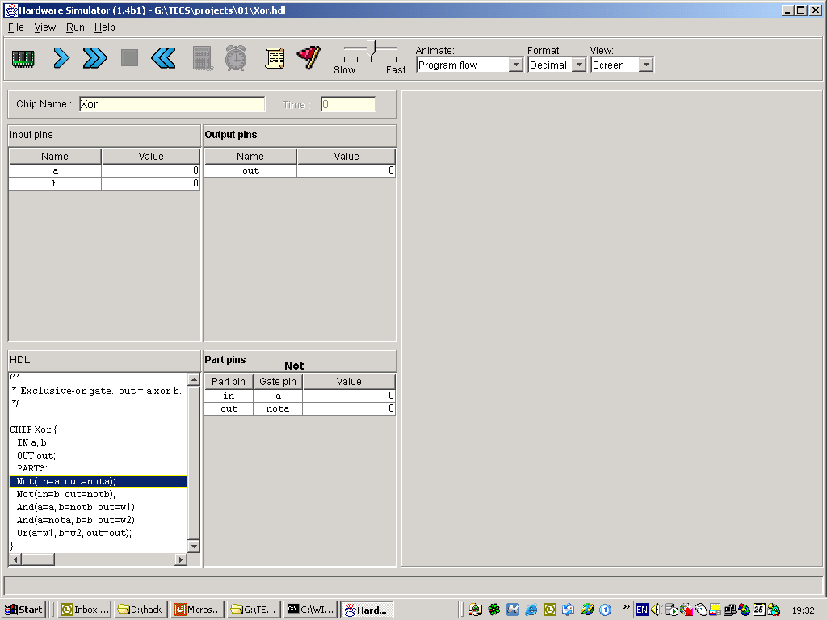
Exploring the Chip Logic
2. A table pops up, showing the input/output pins of the selected part (actually, its API), and their current values;
A convenient debugging tool.
1. Click any one of the chip PARTS

Slide 13
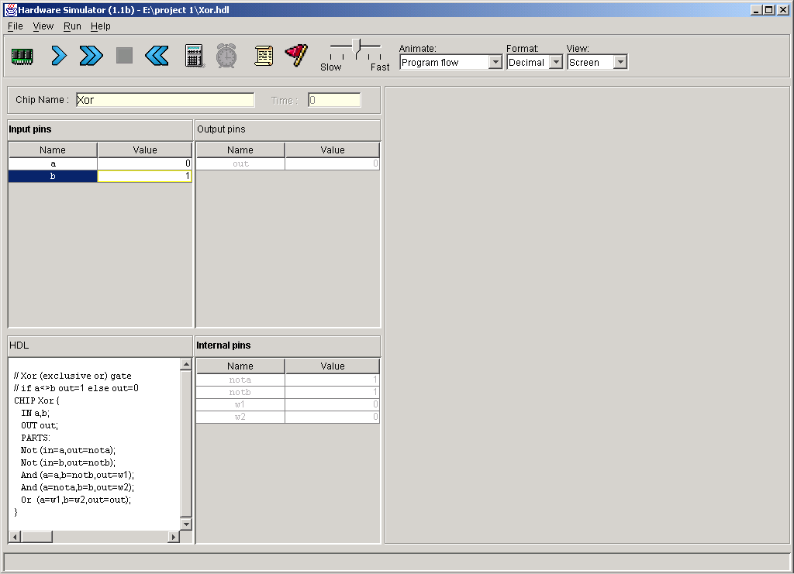
Interactive Chip Testing
1. User: changes the values of some input pins
2. Simulator: responds by:
Darkening the output and internal pins, to indicate that the displayed values are no longer valid
Enabling the eval
(calculator-shaped) button.

Slide 14
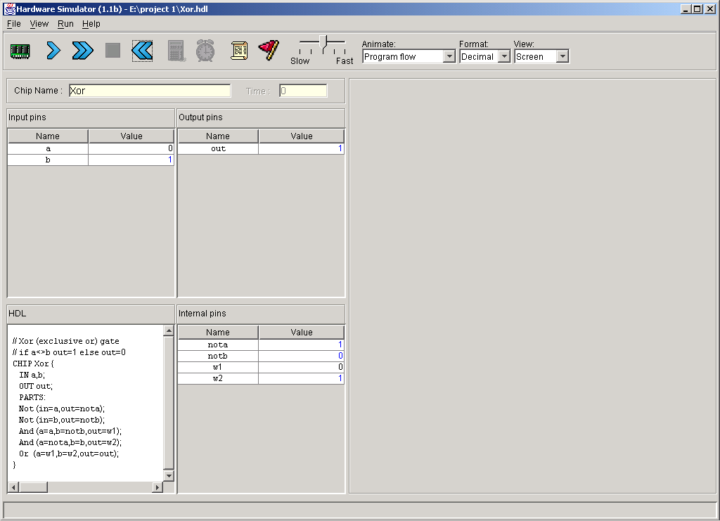
Interactive Chip Testing
1. User: changes the values of some input pins
2. Simulator: responds by:
Darkening the output and internal pins, to indicate that the displayed values are no longer valid
Enabling the eval
(calculator-shaped) button.
Re-
calc
3. User: Clicked the eval button
4. Simulator: re-calculates the values
of the chip’s internal and output
pins (i.e. applies the chip logic to
the new input values)
5. To continue interactive testing,
enter new values into the input
pins and click the eval button.

Slide 15
Hardware Simulation Tutorial
Part II:
Test Scripts

Slide 16
Test Scripts
load Xor.hdl,
output-file Xor.out,
compare-to Xor.cmp,
output-list a%B3.1.3
b%B3.1.3
out%B3.1.3;
set a 0,
set b 0,
eval,
output;
set a 0,
set b 1,
eval,
output;
Etc.
Test scripts:
Are used for specifying, automating and replicating chip testing
Are supplied for every chip mentioned in the book (so you don’t have to write them)
Can effect, batch-style, any operation that can be done interactively
Are written in a simple language described in Appendix B of the book
Can create an output file that records the results of the chip test
Init
Simulation step
Generated output file
(Xor.out)
Simulation step
| a | b | out |
| 0 | 0 | 0 |
| 0 | 1 | 1 |
| 1 | 0 | 1 |
| 1 | 1 | 0 |
If the script specifies a compare file, the simulator will compare the .out file to the .cmp file, line by line.

Slide 17
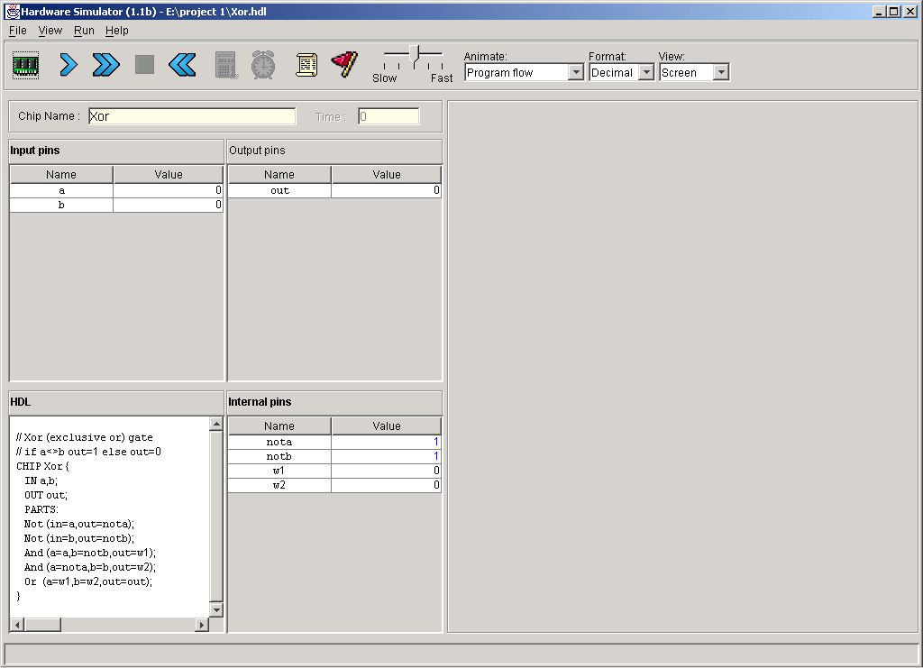
Loading a Script
To load a new script (.tst file), click this button;
Interactive loading of the chip itself (.hdl file) may not be necessary, since the test script typically contains a “load chip” command.

Slide 18
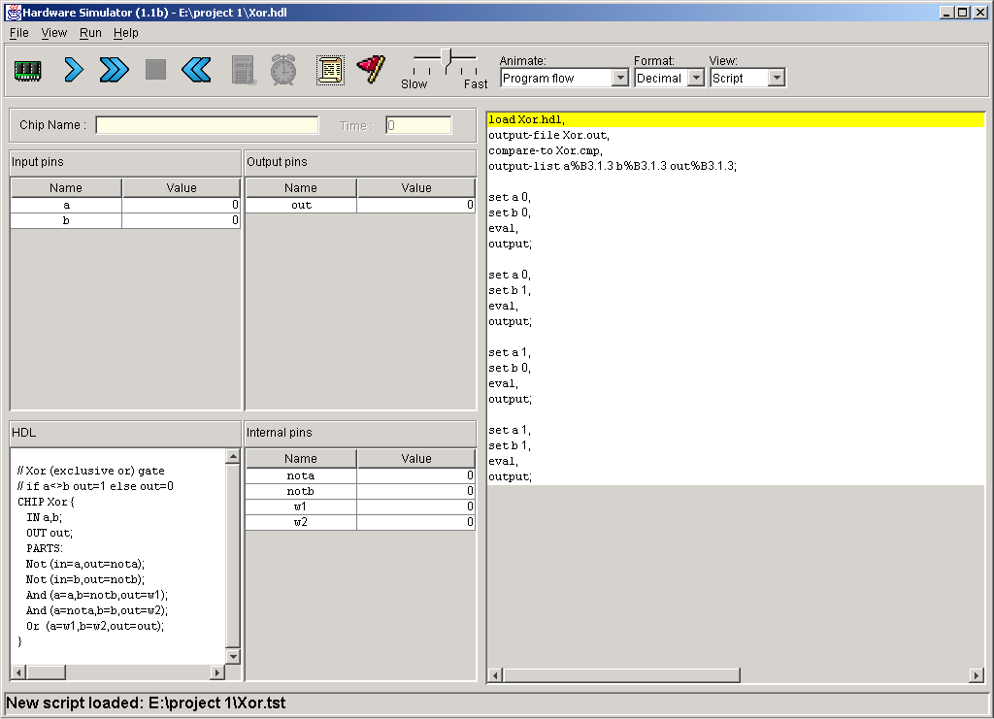
Script Controls
Controls the script execution speed
Script = series of simulation steps, each ending with a semicolon.
Resets
the script
Pauses the script execution
Multi-step execution, until a pause
Executes the next simulation step

Slide 19
Running a Script
Script
exec-
ution
flow
Typical “init” code:
Loads a chip definition (.hdl) file
Initializes an output (.out) file
Specifies a compare (.cmp) file
Declares an output line format.

Slide 20
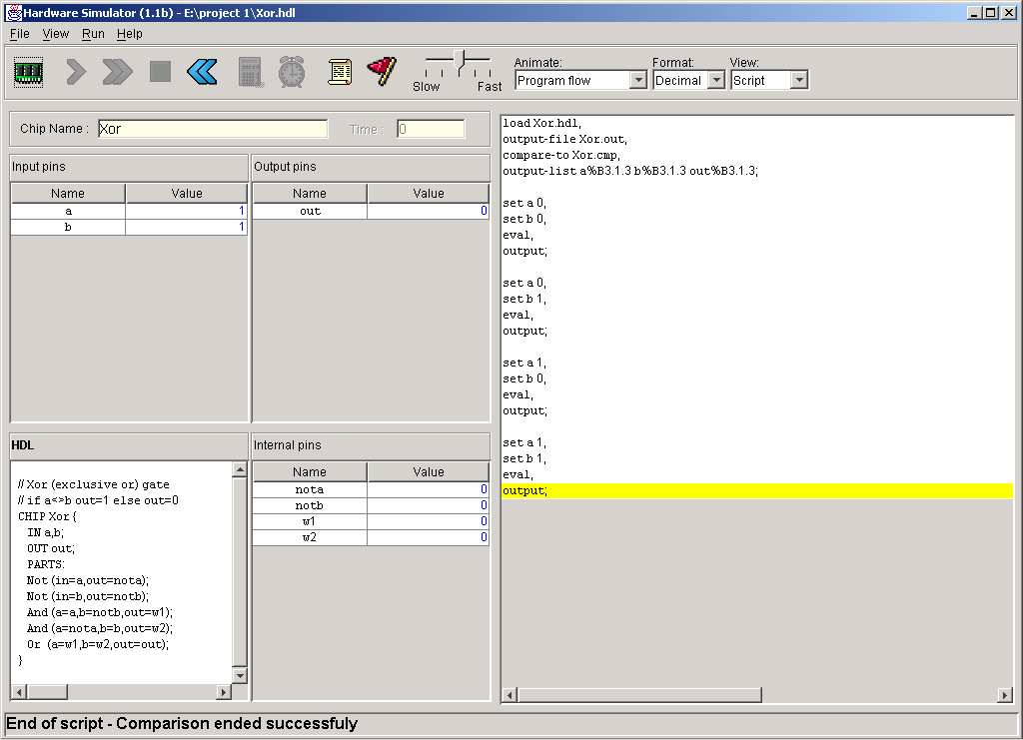
Running a Script
Comparison of the output lines to the lines of the .cmp file are reported.
Script
exec-
ution
ends

Slide 21
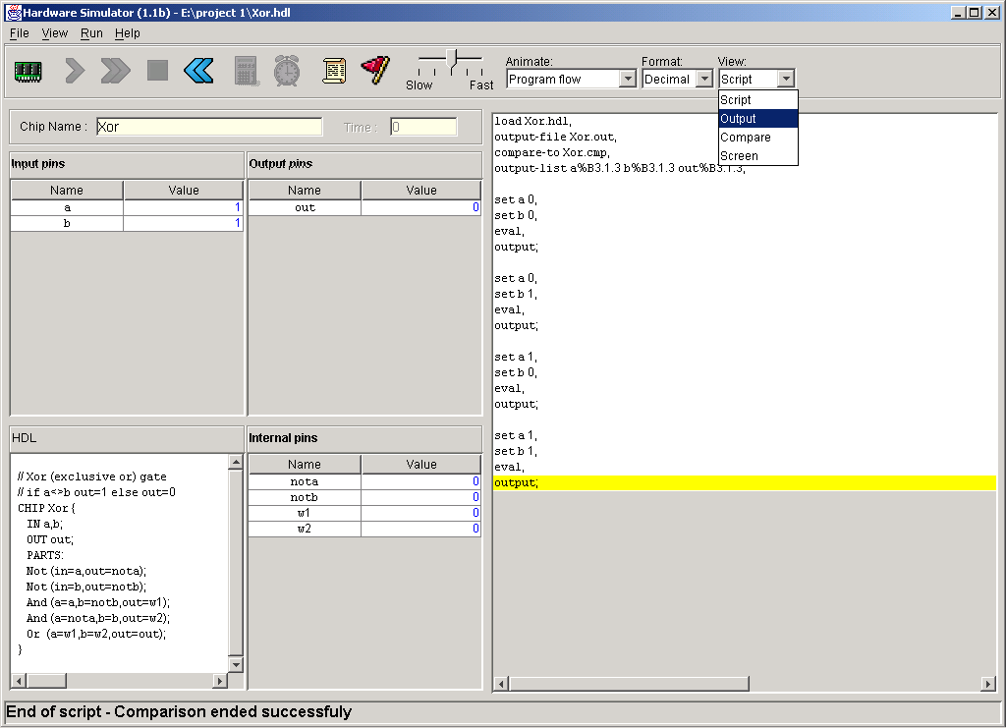
Viewing Output and Compare Files

Slide 22
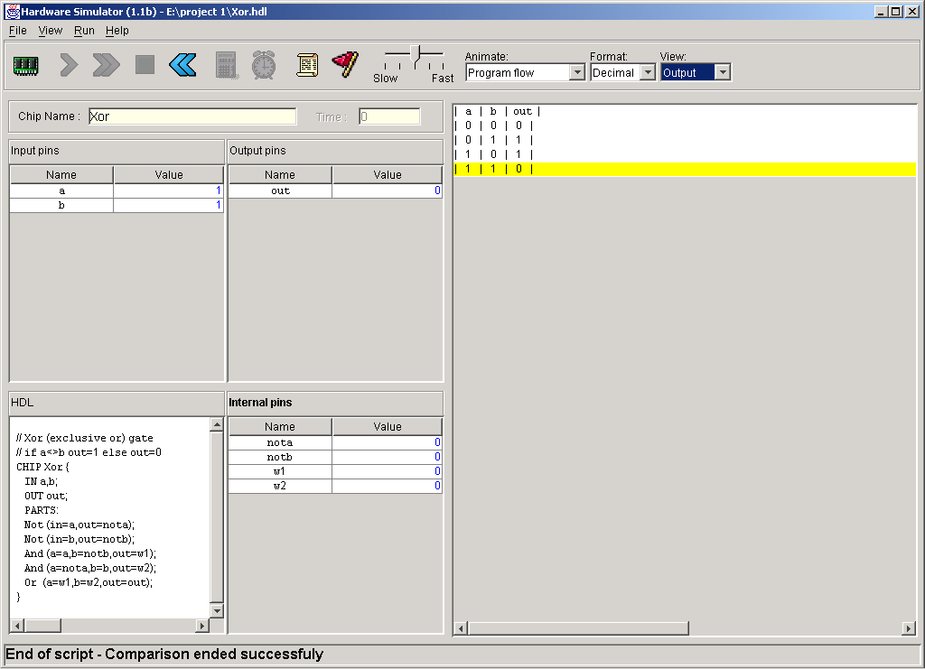
Viewing Output and Compare Files
Observation:
This output file looks like a Xor truth table
Conclusion: the chip logic (Xor.hdl) is apparently correct (but not necessarily efficient).

Slide 23
Hardware Simulation Tutorial
Part III:
Built-in Chips

Slide 24
Built-In Chips
General
A built-in chip has an HDL interface and a Java implementation (e.g. here: Mux16.class)
The name of the Java class is specified following the BUILTIN keyword
Built-In implementations of all the chips that appear in he book are supplied in the tools/buitIn directory.
// Mux16 gate (example)
CHIP Mux16 {
IN a[16],b[16],sel;
OUT out[16];
BUILTIN Mux16;
}
Built-in chips are used to:
Implement primitive gates (in the computer built in this book: Nand and DFF)
Implement chips that have peripheral side effects (like I/O devices)
Implement chips that feature a GUI (for debugging)
Provide the functionality of chips that the user did not implement for some reason
Improve simulation speed and save memory (when used as parts in complex chips)
Facilitate behavioral simulation of a chip before actually building it in HDL
Built-in chips can be used either explicitly, or implicitly.

Slide 25
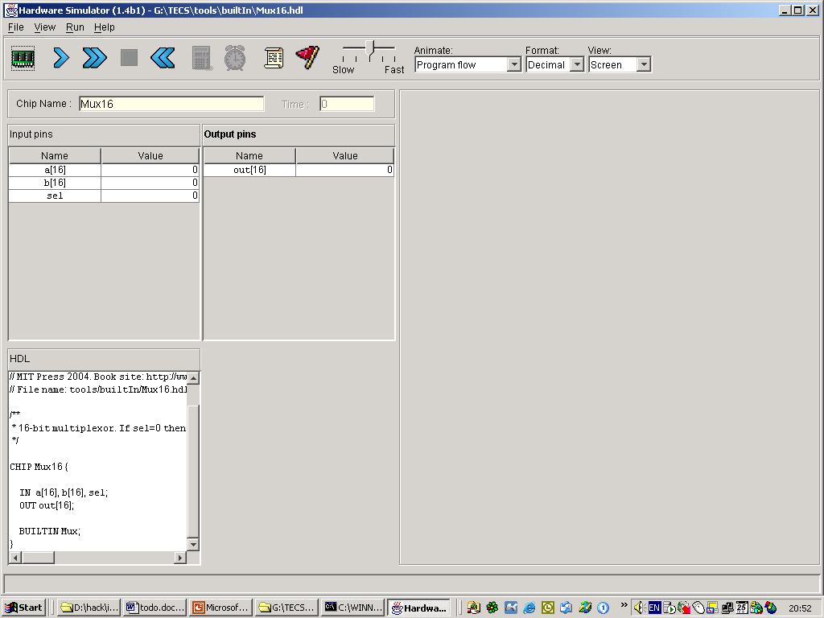
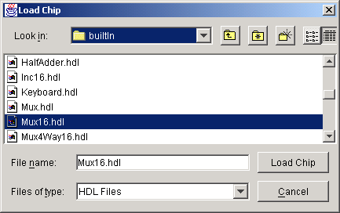
Explicit Use of Built-in Chips
The chip is loaded from the tools/buitIn directory (includes executable versions of all the chips mentioned in the book).
Standard interface.
Built-in implementation.

Slide 26
Implicit Use of Built-in Chips
/** Exclusive-or gate. out = a xor b */
CHIP Xor {
IN a, b;
OUT out;
PARTS:
Not(in=a,out=Nota);
Not(in=b,out=Notb);
And(a=a,b=Notb,out=aNotb);
And(a=Nota,b=b,out=bNota);
Or(a=aNotb,b=bNota,out=out);
}
When any HDL file is loaded, the simulator parses its definition. For each internal chip Xxx(...) mentioned in the PARTS section, the simulator looks for an Xxx.hdl file in the same directory (e.g. Not.hdl, And.hdl, and Or.hdl in this example).
If Xxx.hdl is found in the current directory (e.g. if it was also written by the user), the simulator uses its HDL logic in the evaluation of the overall chip.
If Xxx.hdl is not found in the current directory, the simulator attempts to invoke the file tools/builtIn/Xxx.hdl instead.
And since tools/builtIn includes executable versions of all the chips mentioned in the book, it is possible to build and test any of these chips before first building their lower-level parts.

Slide 27
Hardware Simulation Tutorial
Part IV:
Clocked Chips
(Sequential Logic)

Slide 28
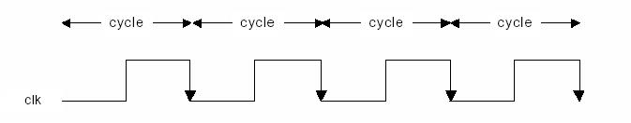
Clocked (Sequential) Chips
The implementation of clocked chips is based on sequential logic
The operation of clocked chips is regulated by a master clock signal:
In our jargon, a clock cycle = tick-phase (low), followed by a tock-phase (high)
During a tick-tock, the internal states of all the clocked chips are allowed to change, but their outputs are “latched”
At the beginning of the next tick, the outputs of all the clocked chips in the architecture commit to the new values
In a real computer, the clock is implemented by an oscillator; in simulators, clock cycles can be simulated either manually by the user, or repeatedly by a test script.

Slide 29
The D-Flip-Flop (DFF) Gate
/** Data Flip-flop:
* out(t)=in(t-1)
* where t is the time unit.
*/
CHIP DFF {
IN in;
OUT out;
BUILTIN DFF;
CLOCKED in, out;
}
Clocked chips
Clocked chips include registers, RAM devices, counters, and the CPU
The simulator knows that the loaded chip is clocked when one or more of its pins is declared “clocked”, or one or more of its parts (or sub-parts, recursively) is a clocked chip
In the hardware platform built in the book, all the clocked chips are based, directly or indirectly, on (many instances of) built-in DFF gates.
DFF:
A primitive memory gate that can “remember” a state over clock cycles
Can serve as the basic building block of all the clocked chips in a computer.

Slide 30
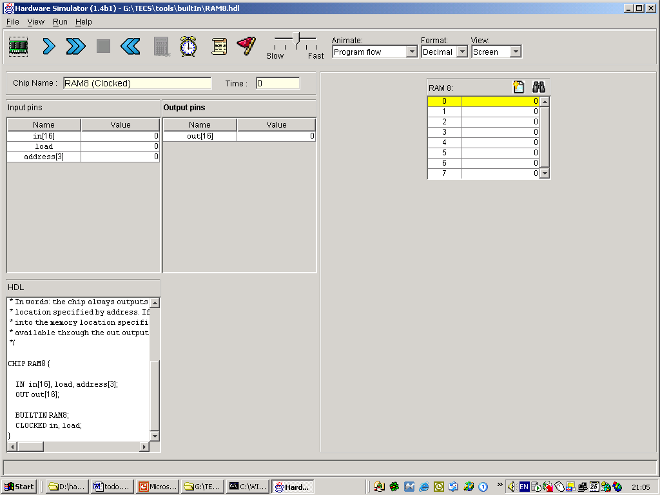
Simulating Clocked Chips
Clocked (sequential) chips are clock-regulated.
Therefore, the standard way to test a clocked chip is to set its input pins to some values (as with combinational chips), simulate the progression of the clock, and watch how the chip logic responds to the ticks and the tocks.
For example, consider the simulation of an 8-word random-access memory chip (RAM8).
Since this built-in chip also happens to be GUI- empowered, the simulator displays its GUI
(More about GUI-empowered chips, soon)
A built-in, clocked chip (RAM8) is loaded

Slide 31
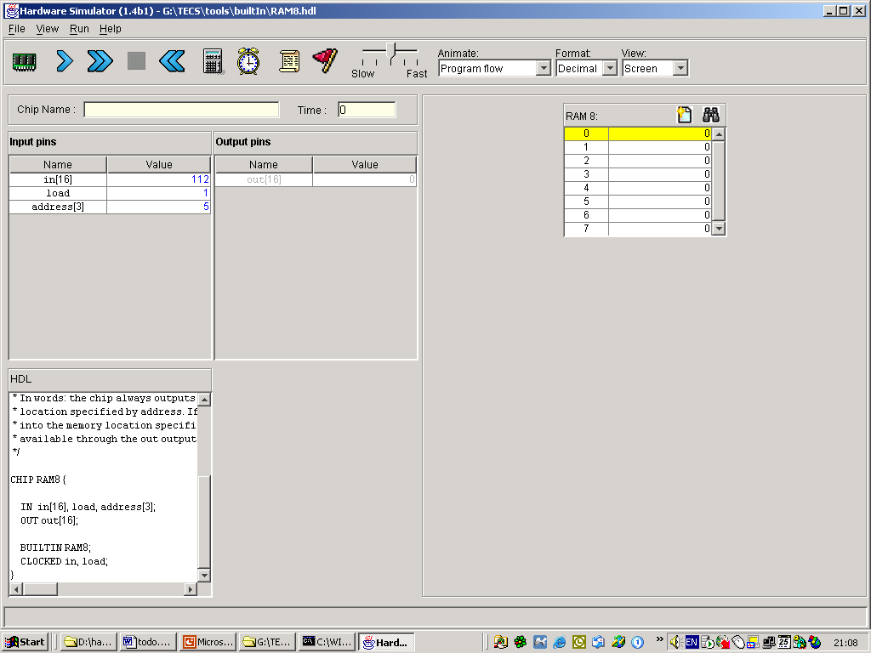
Simulating Clocked Chips
1. User: enters some input values and clicks the clock icon once (tick)
A built-in, clocked chip (RAM8) is loaded

Slide 32
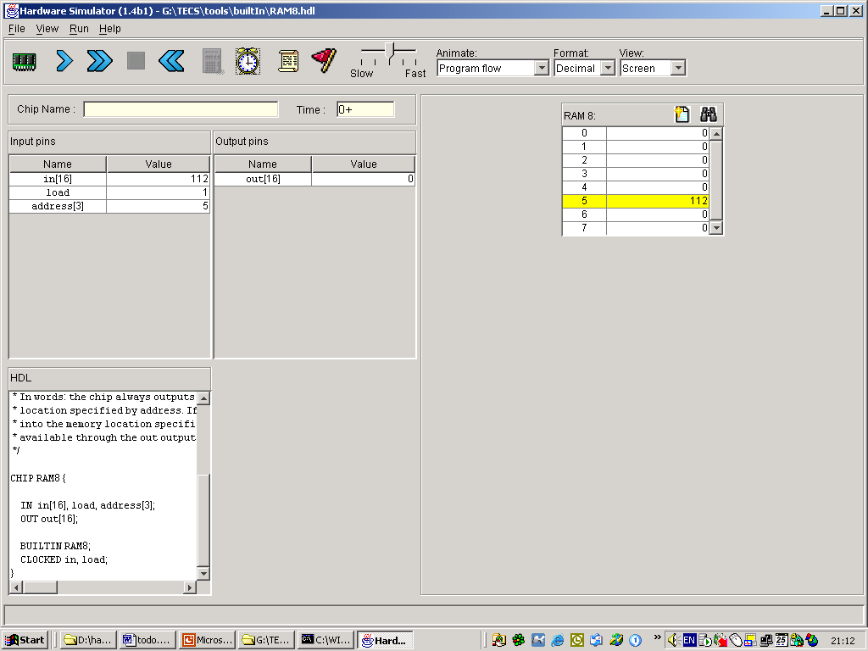
Simulating Clocked Chips
1. User: enters some input values and clicks the clock icon once (tick)
2. Simulator: changes the internal state of the chip, but note that the chip’s output pin is not yet effected.
A built-in, clocked chip (RAM8) is loaded

Slide 33
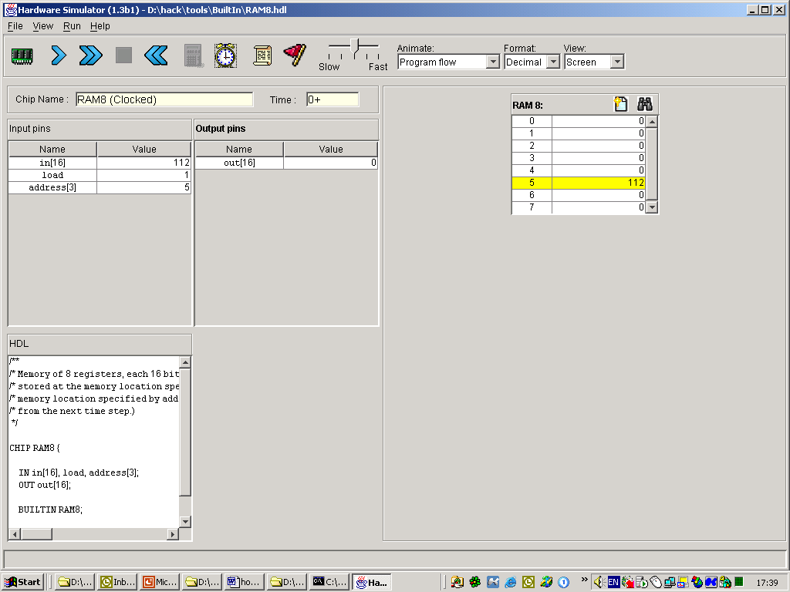
Simulating Clocked Chips
3. User: clicks the clock icon again (tock)
1. User: enters some input values and clicks the clock icon once (tick)
2. Simulator: changes the internal state of the chip, but note that the chip’s output pin is not yet effected.
A built-in, clocked chip (RAM8) is loaded

Slide 34

Simulating Clocked Chips
3. User: clicks the clock icon again (tock)
1. User: enters some input values and clicks the clock icon once (tick)
4. Simulator: commits the chip’s output pin to the value of the chip’s internal state.
2. Simulator: changes the internal state of the chip, but note that the chip’s output pin is not yet effected.
A built-in, clocked chip (RAM8) is loaded

Slide 35
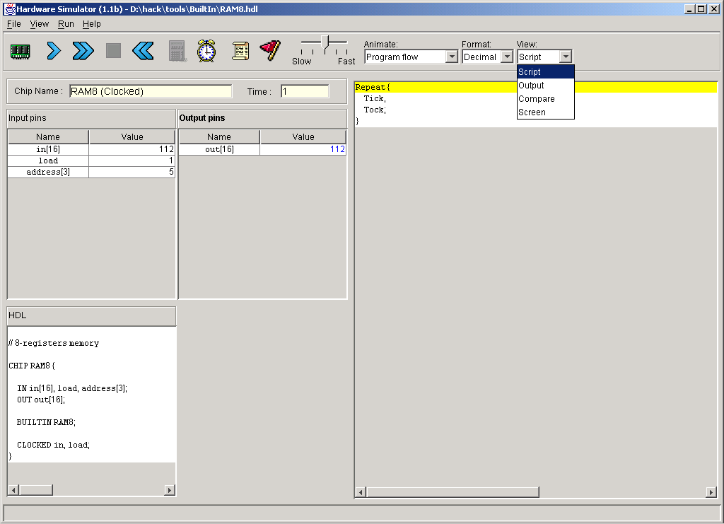
Simulating Clocked Chips Using a Test Script
Controls the script speed, and thus the simulated clock speed, and thus the overall chip execution speed
Default script: always loaded when the simulator starts running;
The logic of the default script simply runs the clock repeatedly;
Hence, executing the default script has the effect of causing the clock to go through an infinite train of tics and tocks.
This, in turn, causes all the clocked chip parts of the loaded chip to react to clock cycles, repeatedly.
Single-action tick-tock
Tick-tocks repeatedly and infinitely

Slide 36
Hardware Simulation Tutorial
Part V:
GUI-Empowered
chips

Slide 37
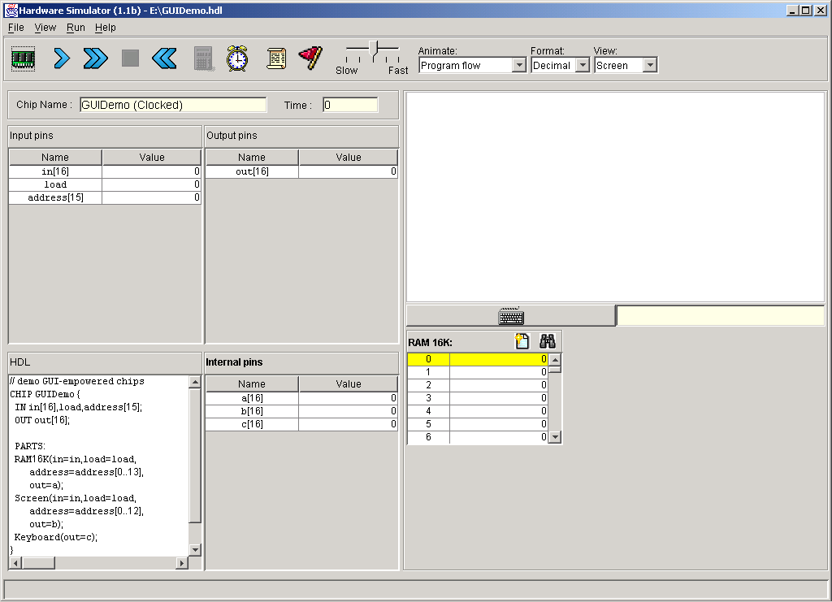
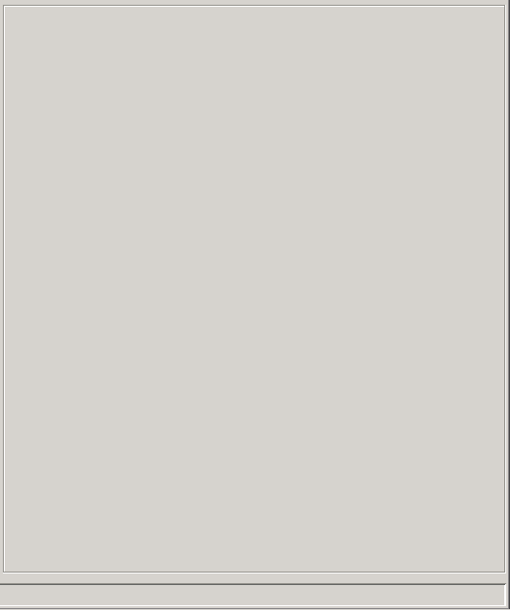
Built-in Chips with GUI Effects
1. A chip whose parts include built-in chips was loaded into the simulator
(ignore the chip logic for now)
Note: the signature of the internal part does not reveal if the part is implemented by a built-in chip or by another chip built by the user. Thus in this example you have to believe us that all the parts of this loaded chip are built-in chips.

Slide 38
Built-in Chips with GUI Effects
2. If the loaded chip or some of its parts have GUI side-effects, the simulator displays the GUI’s here.
For each GUI-empowered built-in chip that appears in the definition of the loaded chip, the simulator does its best to put the chip GUI in this area.
The actual GUI’s behaviors are then effected by the Java classes that implement the built-in chips.
GUI of the built-in Screen.hdl chip
1. A chip whose parts include built-in chips was loaded into the simulator
(ignore the chip logic for now)
GUI of the built-in Keyboard.hdl chip
GUI of the built-in RAM16K.hdl chip

Slide 39
The Logic of the GUIDemo Chip
RAM16K, Screen, & Keyboard are built-in chips with GUI side-effects
// Demo of built-in chips with GUI effects
CHIP GUIDemo {
IN in[16],load,address[15];
OUT out[16];
PARTS:
RAM16K(in=in,load=load,address=address[0..13],out=null);
Screen(in=in,load=load,address=address[0..12],out=null);
Keyboard(out=null);
}
Effect: When the simulator evaluates this chip, it displays the GUI side-effects of its built-in chip parts
Chip logic: The only purpose of this demo chip is to force the simulator to show the GUI of some built-in chips. Other than that, the chip logic is meaningless: it simultaneously feeds the 16-bit data input (in) into the RAM16K and the Screen chips, and it does nothing with the keyboard.

Slide 40
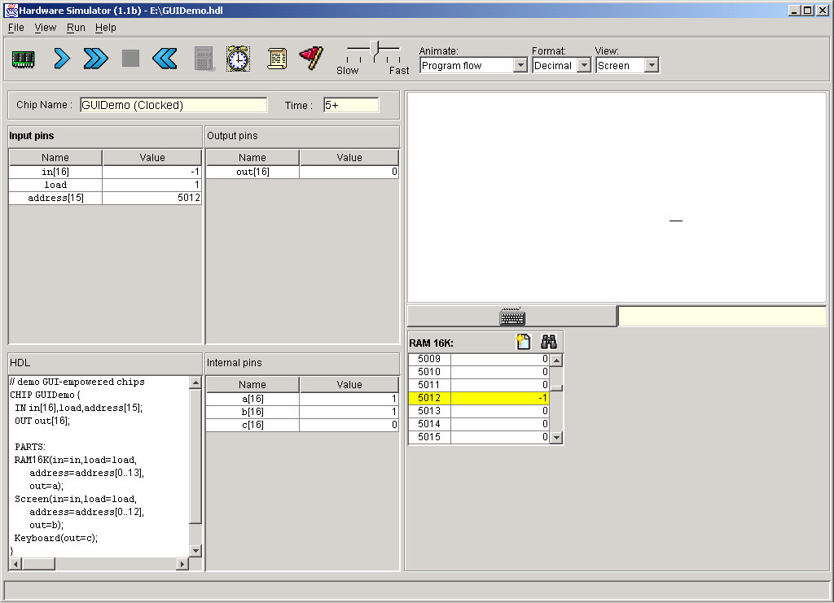
GUIDemo Chip in Action
3. 16 black pixels are drawn beginning in row = 156
col = 320
2. User: runs the clock
1. User enters:
in = –1
(=16 1’s in binary)
address = 5012
load = 1
Explanation: According to the specification of the computer architecture described in the book, the pixels of the physical screen are continuously refreshed from an 8K RAM-resident memory map implemented by the Screen.hdl chip. The exact mapping between this memory chip and the actual pixels is specified in Chapter 5. The refresh process is carried out by the simulator.
3. The chip logic routes the in value simultaneously into the Screen chip and the RAM16K chip

Slide 41
Hardware Simulation Tutorial
Part VI:
Debugging tools

Slide 42
System Variables
The simulator recognizes and maintains the following variables:
Time: the number of time-units (clock-cycles) that elapsed since the script started running is stored in the variable time
Pins: the values of all the input, output, and internal pins of the simulated chip are accessible as variables, using the names of the pins in the HDL code
GUI elements: the values stored in the states of GUI-empowered built-in chips can be accessed via variables. For example, the value of register 3 of the RAM8 chip can be accessed via RAM8[3].
All these variables can be used in scripts and breakpoints, for debugging.

Slide 43
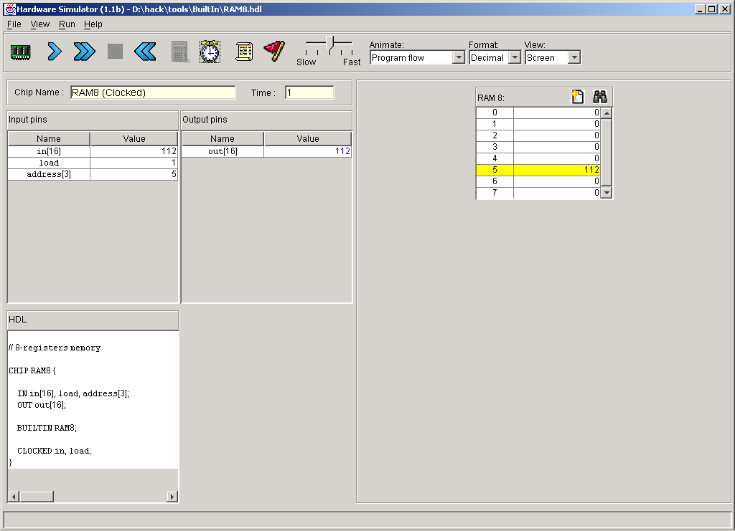
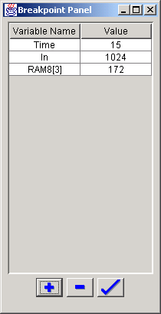
Breakpoints
2. Previously-declared breakpoints
1. Open the breakpoints panel
3. To update an existing breakpoint, double-click it
The breakpoints logic:
Breakpoint = (variable, value)
When the specified variable in some breakpoint reaches its specified value, the script pauses and a message is displayed
A powerful debugging tool.
3. Add, delete, or update breakpoints

Slide 44
Scripts for Testing the Topmost Computer chip
load Computer.hdl
ROM32K load Max.hack,
output-file ComputerMax.out,
compare-to ComputerMax.cmp,
output-list time%S1.4.1
reset%B2.1.2
ARegister[]%D1.7.1
DRegister[]%D1.7.1
PC[]%D0.4.0
RAM16K[0]%D1.7.1
RAM16K[1]%D1.7.1
RAM16K[2]%D1.7.1;
breakpoint PC 10;
// First run: compute max(3,5)
set RAM16K[0] 3,
set RAM16K[1] 5,
output;
repeat 14 {
tick, tock, output;
}
// Reset the PC (preparing for
// second run)
set reset 1,
tick, tock, output;
// Etc.
clear-breakpoints;
Scripts that test the CPU chip or the Computer chip described in the book usually start by loading a machine-language program (.asm or .hack file) into the ROM32K chip
The rest of the script typically uses various features like:
  Output files
  Loops
  Breakpoints
  Variables manipulation
  tick, tock
  Etc.
All these features are described in Appendix B of the book (Test Scripting Language).

Slide 45
Visual Options
Program flow: animates the flow of the currently loaded program
Program & data flow: animates the flow of the current program and the data flow throughout the GUI elements displayed on the screen
No animation (default): program and data flow are not animated.
Tip: When running programs on the CPU or Computer chip, any animation effects slow down the simulation considerably.
Format of displayed pin values:
Decimal (default)
Hexadecimal
Binary
Script: displays the current test script
Output: displays the generated output file
Compare: displays the supplied comparison file
Screen: displays the GUI effects of built-in chips, if any.

Slide 46
Hardware Simulation Tutorial
Part VII:
The Hack
Hardware Platform

Slide 47
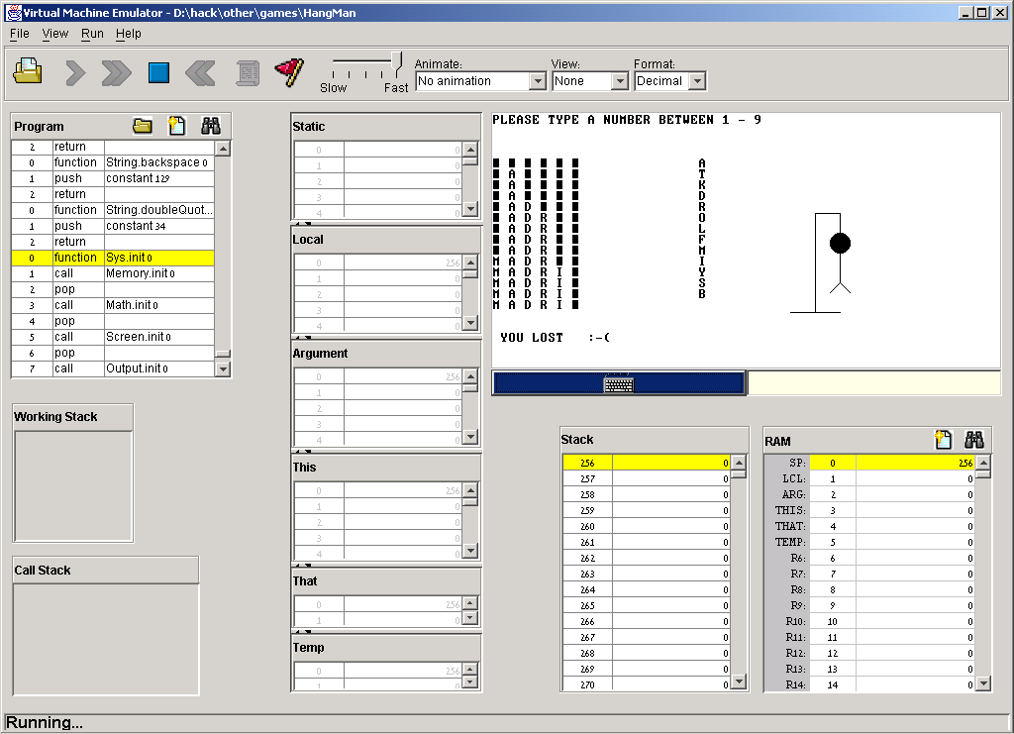
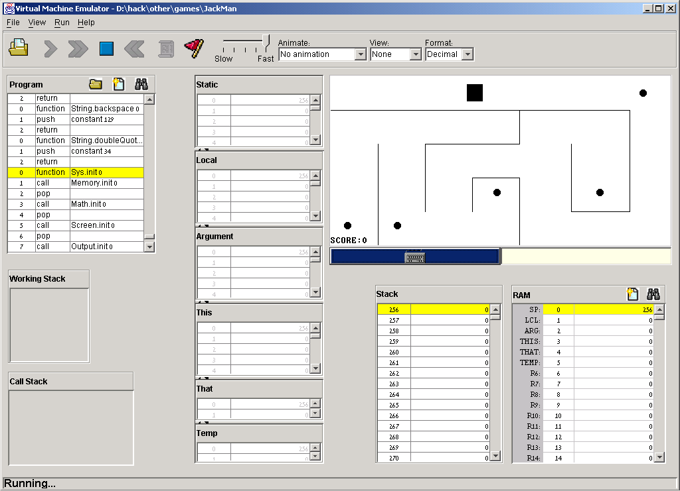
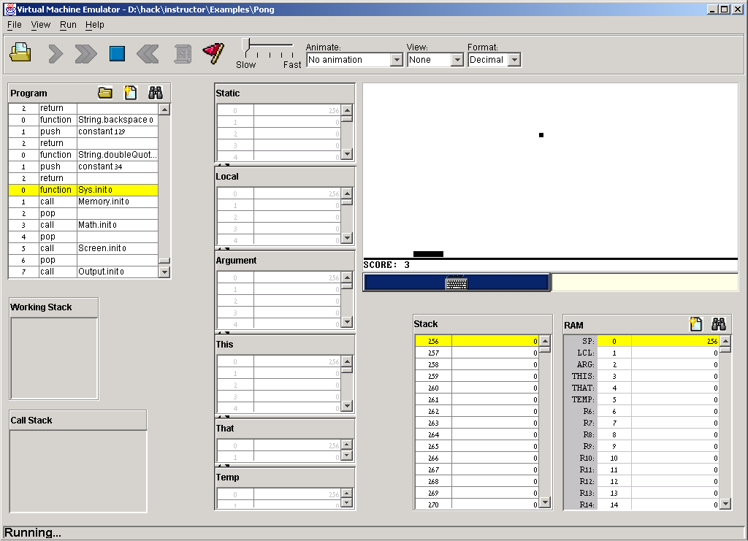
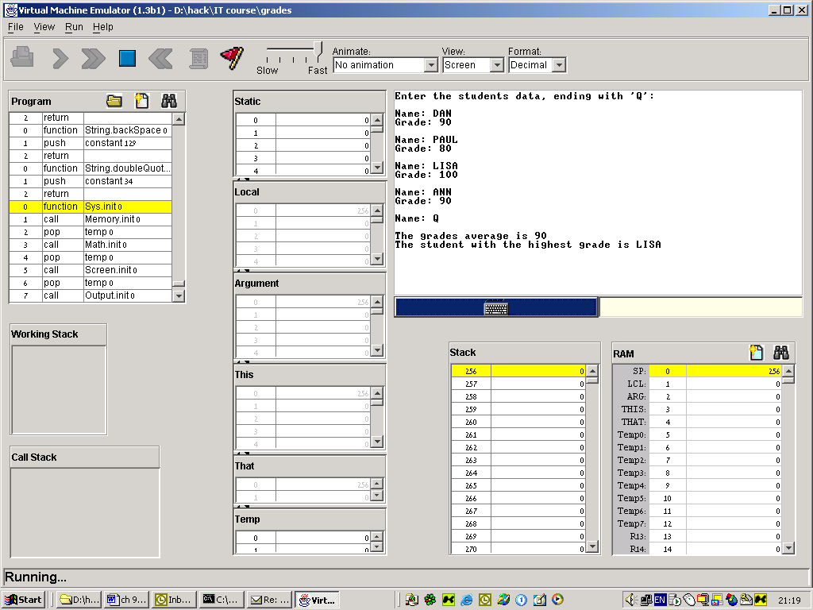
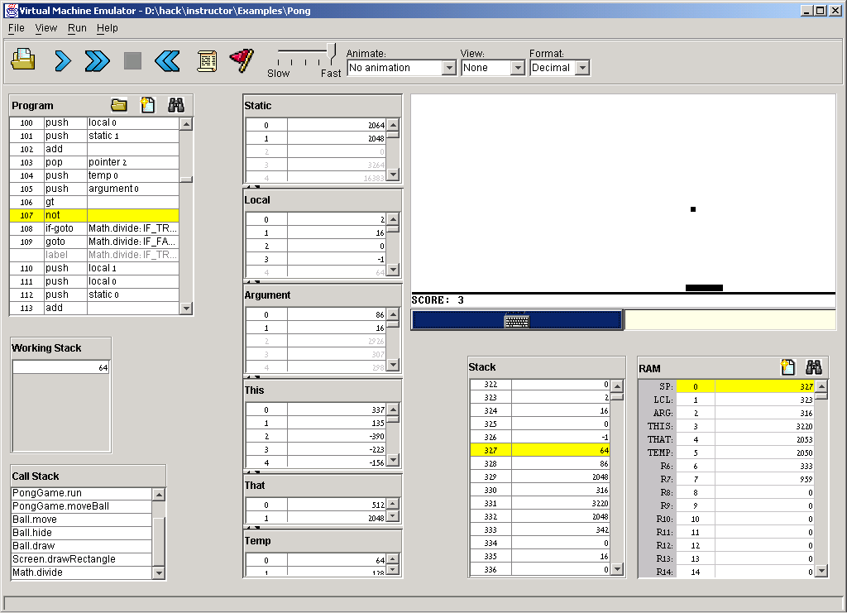
Hack: a General-Purpose 16-bit Computer
Sample applications running on the Hack computer:
Hang Man
Maze
Pong
Grades Stats
These programs (and many more) were written in the Jack programming language, running in the Jack OS environment over the Hack hardware platform. The hardware platform is built in chapters 1-5, and the software hierarchy in chapters 6-12.

Slide 48
The Hack Chip-Set and Hardware Platform
Elementary logic gates
(Project 1):
Nand (primitive)
Not
And
Or
Xor
Mux
Dmux
Not16
And16
Or16
Mux16
Or8Way
Mux4Way16
Mux8Way16
DMux4Way
DMux8Way
Combinational chips
(Project 2):
HalfAdder
FullAdder
Add16
Inc16
ALU
Sequential chips
(Project 3):
DFF (primitive)
Bit
Register
RAM8
RAM64
RAM512
RAM4K
RAM16K
PC
Computer Architecture
(Project 5):
Memory
CPU
Computer
Most of these chips are generic, meaning that they can be used in the construction of many different computers.
The Hack chip-set and hardware platform can be built using the hardware simulator, starting with primitive Nand.hdl and DFF.hdl gates and culminating in the Computer.hdl chip.
This construction is described in chapters 1,2,3,5 of the book, and carried out in the respective projects.

